Slide 1
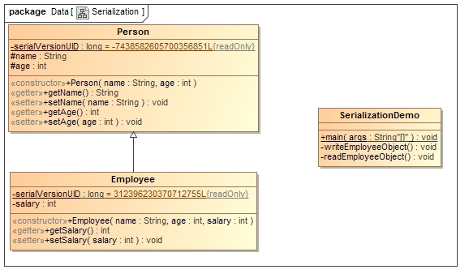
Java Serialization with Inheritance (IS-A Relationship)
Person class implements Serializable,So all of its subclasses will also be serializable.

